Slide 1
TRAVIO.
LIVE
ADVENTURE

Slide 2

TRAVIO.
Guided by : Prof. Jaya Zade

Slide 3

INTRODUCTION
TRAVIO. involves the management of multitude of activities such as studying tour destination, planning the tour, making travel arrangements and providing accommodation. It also involves marketing efforts to attract tourists to travel to particular destinations.

Slide 4

ABSTRACT
TRAVIO. is a complete tourist fully integrated tourism web site. The website covers all the areas required for an including tourism, This project is developed to manage the tourist in the tourism management web site. The main module in this project are login, tours management and testimonials.

Slide 5
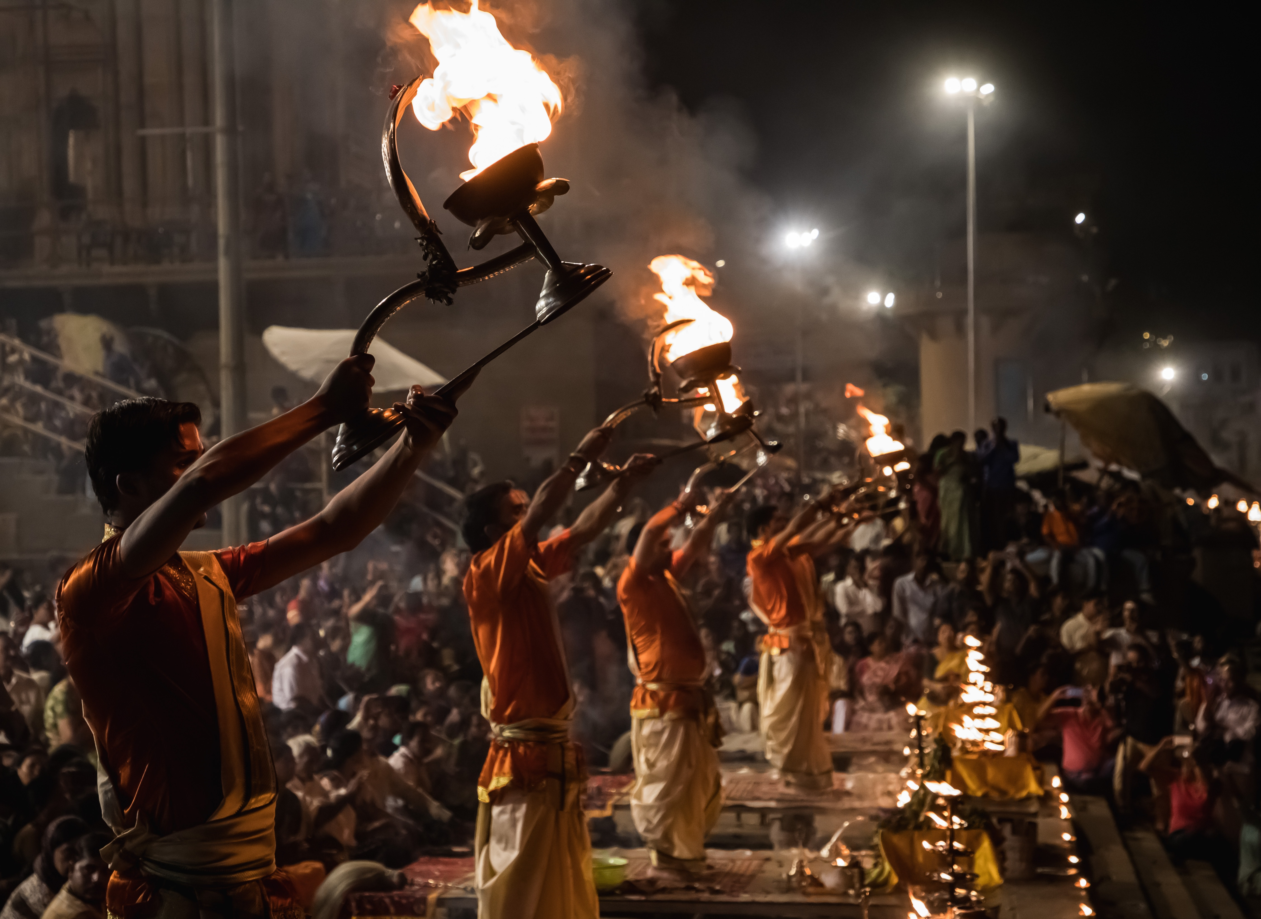
IMPLEMENTATION

Slide 6

ADVANTAGES
Itinerary
Economic Growth
Employment Creation
Being More Culturally Sensitive
The Development of a Country
Unification of Various Socities

Slide 7

CONCLUSION
TRAVIO. proves to be a strong system which has followed all the industrial standards. The functional dependencies are also listed. Working with such a system can enable the user to get any information with low performance cost and increased throughput. As the database is created with good design, the system can comply with any demand in the future. Also, the relational algebraic translation proves that the database is designed properly.

Slide 8

REFERENCES
Bart´ak, R., Zhou, N.: Using tabled logic programming to solve the petrobras planning problem. TPLP 14(4-5), 697–710 (2014)
Basseda, R.: Planning with Transaction Logic. Ph.D. thesis, Stony Brook, NY, USA (2015)
Blum, A.L., Furst, M.L.: Fast planning through planning graph analysis. Artiﬁcial Intelligence 90(12), 281 – 300 (1997)
Blum, A.L., Furst, M.L.: Fast planning through planning graph analysis. Artif. Intell. 90(1-2), 281–300 (Feb 1997)
Steﬁk, M.J.: Planning with Constraints. Ph.D. thesis, Stanford, CA, USA (1980), aAI8016868

Slide 9

THANK YOU!
FROM TEAM J.C.G

